Slide 1
Pharmacology of The Nervous System
Pharmacy year II
Bezawit Alem (B pharm, MSc in Pharmacology)
Bezawita7@gmail.com

Slide 2
Outlines
Introduction to the nervous system
Pharmacology of autonomic nervous system (ANS)
  anatomy and physiology of ANS
  neurotransmitters and receptors
  Drugs acting on the ANS
Pharmacology of the central nervous system ( CNS)
  Anatomy and physiology of CNS
  neurotransmitters and receptors
  Drugs acting on CNS

Slide 3
Introduction
The nervous system is the fast acting regulator of homeostasis.
It works together with the endocrine system
  to monitor the internal & external environments
    Through chemical transmission

Slide 4
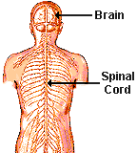
The nervous system is divided into “2 systems”
Central Vs. Peripheral
Afferent Efferent
Sensory TO the Brain
Sensory FROM the Brain
somatic vs. autonomic
Motor Control
Physiological Control
parasympathetic sympathetic
Cholinergic Adrenergic
parasympathetic & sympathetic are ANTAGONISTIC in their responses,
cholinergic & adrenergic agonists tend to have opposite effects

Slide 5
  Anatomy and Physiology of ANS
ANS use chemicals for the transmission of information
  Chemicals are small molecules known as neurotransmitters
  Neurotransmitters in ANS include,
    Acetylcholine
    Noradrenaline
    Adrenaline
    Dopamine

Slide 6
Cont…
The ANS is divided into two major portions
  Sympathetic (adrenergic)
    Exit from thoracic and lumbar regions
    Preganglionic neuron is shorter than postganglionic neuron
    Neurotransmitter- norepinephrine
    Adrenergic receptors- α1, α2, β1, β2, β3
    Fight or flight action
Notes:
Note that some sympathetic postganglionic fibers release acetylcholine rather than norepinephrine. During Sympathetic stimulation sweat gland secretion is increased through muscarinic (M) receptor stimulation by acetylcholine.

Slide 7
Cont…
  Parasympathetic (cholinergic)
    Exit from cranial and sacral portions
    Preganglionic neuron is longer than postganglionic neuron
    Neurotransmitter- acetylcholine
    Cholinergic receptors- NN, NM, M
    Rest or digest

Slide 8
Cont…
In the ANS:
  Preganglionic fibers release ACh
  Postganglionic fibers release norepinephrine or ACh and the effect is either stimulatory or inhibitory
  ANS effect on the target organ is dependent upon
  the neurotransmitter released and
  the receptor type of the effector

Slide 9
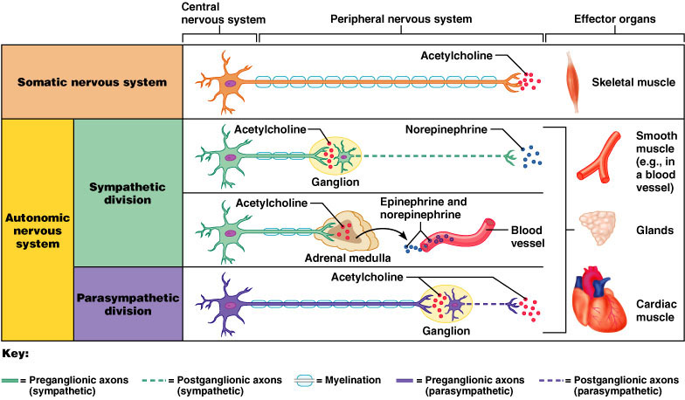
Cont….

Slide 10
Functional differences
Effector Organ | Sympathetic | Parasympathetic
Heart | Heart Rate, force of Contraction, Conduction Velo. increased | decreased
Lungs | Relaxation of bronchial muscle | Contraction
Arterioles skin, mucosa & abdominal visera | constriction | -
Arterioles of skeletal muscles, heart | dilation | constriction
Gastrointestinal tract | GI Motility and secretions decreased | increased
Sweat glands secretion | increased | decreased
Radial muscle of iris | Contraction- mydriasis | -
Sphincter muscle of iris | - | Contraction- miosis
Ciliary muscle | Relaxation-far vision | Contraction - near vision
Secretions | decrease(GI, salivary, Lacrimal, respiratory, nasopharyngeal) | increase

Slide 11
Steps in Synaptic Neurotransmission
There are 5 key steps in neurotransmission
  Synthesis of neurotransmitter from precursor molecules.
  Storage of neurotransmitter in vesicles.
  Release of neurotransmitter by exocytosis,
  Recognition of neurotransmitter by receptors.
  Termination of action of neurotransmitter either by enzyme hydrolysis or by reuptake mechanism.

Slide 13
Receptors of ANS
Cholinergic receptors - mediated response to acetylcholine
has sub types
  Nicotinic receptors – Nm, NN
  Muscarnic receptors _M
Adrenergic receptors - mediated response to adrenaline or nor adrenaline
has sub types.
  Alpha1 ( α1) - Beta1 (B1)
  Alpha2 ( α 2) - Beta2 (B2), Beta 3(B3)

Slide 14
Adrenergic Transmission
Tyrosine in the bloodstream is taken up into nerves and converted into Dopa (catecholamine) by Tyrosine hydroxylase
  rate limiting step
  Excess catecholamines act as feedback inhibitors of this enzyme.
  Sympathetic stimulation increase synthesis of dopa
    inhibited by metyrosine

Slide 15
Adrenergic transmission …….
conversion of dopa to dopamine by dopa decarboxylase.
  Inhibited by carbidopa peripherally
dopamine enter vesicles (inhibited by reserpine) and
  changed to noradrenaline inside the vesicle by dopa hydroxylase.
  Dopamine- cytoplasm
  noradrenaline and adrenaline- vesicle
Released from vesicles
  inhibited by guanathidine

Slide 16
Adrenergic transmission …….
Termination
Mainly by reuptake into nerve terminals by NET
  Inhibited by TCA, Cocaine
Dilution by diffusion out of the junctional cleft and uptake at extraneuronal sites
metabolic transformation
  Monoamineoxidase(MAO)
  catechol-O-methyltransferase (COMT)

Slide 17
Adrenergic transmission …….
Monoamineoxidase(MAO)
  MAO- bound to membrane of mitochondria
  Found in noradrenergic nerve terminals, liver and intestinal epithelium
  converts catecholamines to their corresponding aldehydes.
    Inhibited by MAO inhibitors
  catechol-O-methyltransferase (COMT)
  Catecholamines metabolized by COMT postsynaptically , gut wall
  Inhibited by entacapone and tolcapone

Slide 19
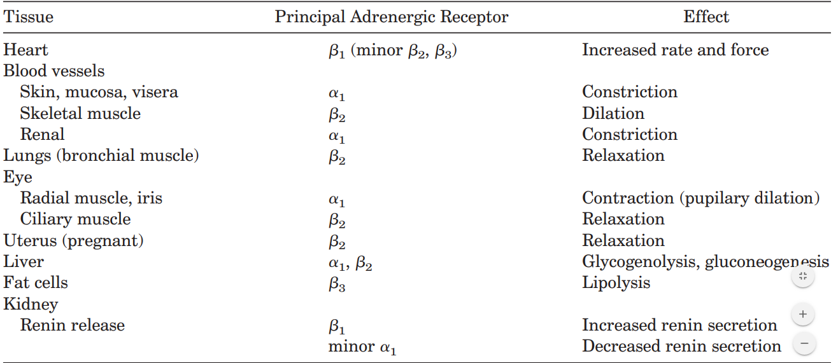
Table 1.1. Selected Tissue Response to Adrenergic Stimulation

Slide 20
Cholinergic Transmission
Transport of choline from the plasma into neurons
  by choline transporters
  rate limiting step in ACh synthesis
  inhibited by hemicholinium
ACh is synthesized by choline acetyltransferase (ChAT)
  a soluble cytoplasmic enzyme that catalyzes the transfer of an acetyl group from acetylcoenzyme A to choline.

Slide 22
Cholinergic transmission…….
Synthesized ACh
  transported into synaptic vesicles via a proton anti-porter
  inhibited by vesamicol
Upon arrival of an action potential in cholinergic neuron
  voltage sensitive calcium channels open
  Ca²⁺ influx
  releases ACh by exocytosis
  trigger a postsynaptic physiological response.
  blocked by botulinum toxin
action terminated
  rapid hydrolysis of ACh into choline and acetic acid
  catalyzed by the enzyme acetylcholinesterase

Slide 23
Functions of Cholinergic receptors
Nicotinic involves in - stimulation of PNS and SNS.
  Release of Adrenaline in case of SNS stimulation
Nicotinic muscular - skeletal muscle contraction (NMJ)
Muscarininc - in all target organs of parasympathetic nerve
  Miosis
  Tense focuses on near vision
  Selective vasodilation (coronary, skin mucus membrane)
  Increased tone and motility of GIT.
  Bronchial constriction and increased bronchial secretion.
  Voiding - contraction of bladder , relaxation of bladder sphincter

Slide 24
Classifications of drugs acting on ANS
Adrenergic (sympathomimetic)
Adrenergic blockers (sympatholytic)
Cholinergic (parasympathomimetic)
Cholinergic blockers (parasympatholytic)

Slide 25
Sympathomimetic drugs
Drugs that mimic the actions of epinephrine or norepinephrine
The sympathomimetics can be grouped based on
Chemical structure
mode of action and
the spectrum of receptors that they activate

Slide 26
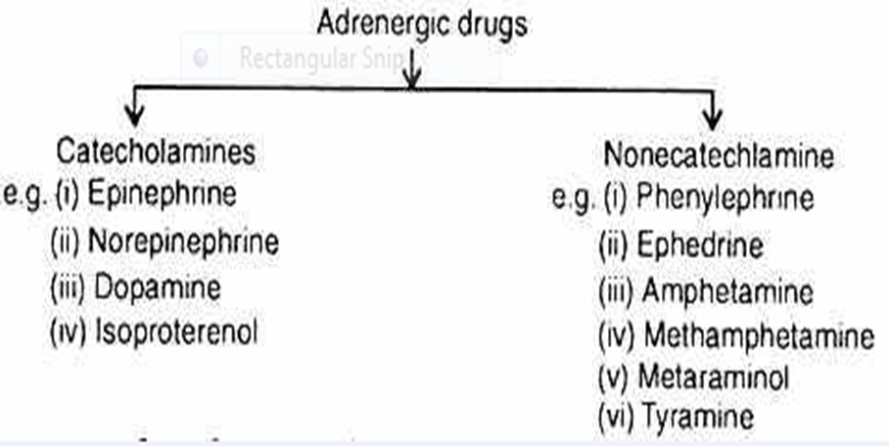
A. On the basis of their chemical structure

Slide 27
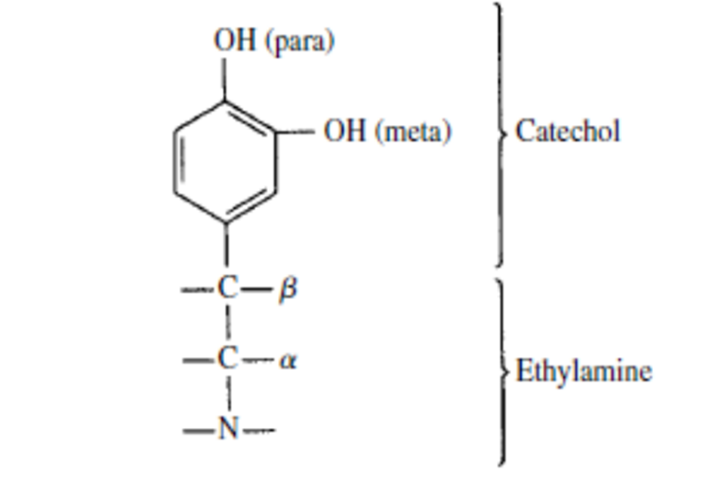
Cont…
A. catecholamines: Compounds which have the catechol nucleus and
have a direct action on sympathetic effectors cells through interactions with receptor sites. includes
norepinephrine, epinephrine, and dopamine (natural)
Isoproterenol (synthetic substances)
B. Noncatecholamine: lack the catechol nucleus
may directly act on the receptors or
may indirectly release the physiologic catecholamines.
ephedrine, phenylephrine, amphetamine

Slide 28
Characteristics of catecholamines
Have short duration of action-rapid inactivation
Rapid onset of action
Need parenteral administration
  Ineffective orally
Have high potency
    α: NE > E > Isoproterenol
    β: Isoproterenol > E > NE
Poor penetration in CNS

Slide 29
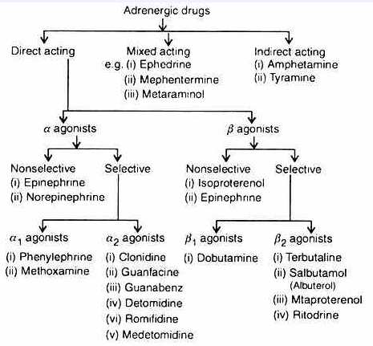
B. based on the basis of mechanism of action

Slide 30
Direct Acting adrenergic agonists
Epinephrine (adrenaline)
A prototype of adrenergic drugs
Is produced in the cells of the Adrenal medulla by chromaffin cells.
Directly stimulates all the adrenergic receptors (α and β )
α effects:
vasoconstriction in skin and viscera,
mydriasis,
platelet aggregation and
some increase in blood glucose.

Slide 31
Cont..
ß effects:
increased contractility and rate of heart (ß1),
vasodilatation in muscles and coronary vessels (ß2),
bronchial relaxation (ß2),
uterine relaxation (ß2),
hyperglycemia,
lactic acidemia and
increased circulating free fatty acids

Slide 32
Cont…
Rapidly destroyed in the GIT, oxidized, and conjugated in the liver.
It is therefore ineffective when given orally and
should be given intramuscularly or subcutaneous.
Intravenous injection is highly dangerous and
is likely to precipitate ventricular fibrillation
Indications
Acute bronchial asthma, Anaphylaxis, Local haemostatic to stop bleeding in epistaxis, with local anesthesia to prolong the action, Cardiac arrest

Slide 33
II. Norepinephrine (levarterenol, noradrenaline)
It differs from epinephrine only by
lacking the methyl substitution in the amino group
Noradrenaline is a predominantly α receptor agonist
with relatively less β agonist (β₂ receptors).
it has to be given intravenously with caution.
not given subcutaneous or intramuscularly
because of its strong vasoconstrictor effect producing necrosis and sloughing.

Slide 34
III. selective a1 receptor agonists
Phenylephrine and Methoxamine
direct-acting selective α1-receptor agonist
may cause a prolonged increase in blood pressure due to vasoconstriction;
it also causes a vagally mediated bradycardia
Because it is not a catechol derivative,
  it is not inactivated by COMT and
has a longer duration of action than the catecholamines
  But Substrate for MAO

Slide 35
IV. Alpha2-selective agonists
( clonidine, methyldopa, guanfacine, guanabenz)
Clonidine: Clonidine is the prototypical a-2 agonist
now most frequently used in the management of hypertension
may exhibit transient increases in blood pressure after initial dosing
because of mild stimulation of peripheral postjunctional a-1 receptor
More recently, clonidine has been used as
  A premedicant in patients with significant pretreatment anxiety and
  To decrease anesthetic requirements by 40–60%.
  And decrease postoperative shivering

Slide 36
Cont…..
Clonidine is also useful in the treatment of
hyperactive behavior seen in attention-deficit/hyperactivity disorder.
chronic pain disorders and
opiate, benzodiazepine, alcohol, cocaine, food, and tobacco withdrawal syndrome

Slide 37
Cont…
Methyldopa (Aldomet)
A pro drug metabolized to active a2 receptor
Act at CNS a2 receptors to decrease sympathetic outflow.
Uses: Hypertension

Slide 38
Cont…
Tizanidine: Tizanidine is another a-2 agonist
Like clonidine, it has sedative, anxiolytic, and analgesic properties,
but it has a shorter duration of action and
less effect on heart rate and blood pressure
reduced the propofol requirement by 25% and
significantly reduced the incidence of postoperative shivering.
It has also been used in the treatment of myofascial pain disorders of the head and neck

Slide 39
V. Non selective β receptor agonists
Isoproterenol:
is a very potent β-receptor agonist and
has little effect on α receptors.
The drug has positive chronotropic and inotropic actions;
because isoproterenol activates β receptors almost exclusively,
  it is a potent vasodilator
These actions lead to a marked increase in cardiac output
Uses for Asthma, Chronic Obstructive Pulmonary Disease (COPD), Cardiostimulant.

Slide 40
VI. Selective β1 receptor agonists
Dobutamine: Dopamine derivative Available as a racemic mixture
(+)-enantiomer potent β1 receptor agonist and
(-)-enantiomer potent a1 receptor agonist,
  potency for β receptors reduced 10X.
Net effect is positive inotropic effect on heart
with little chronotropic effect.
Use for Acute heart failure, shock

Slide 41
VI. Selective β 2 receptor agonists
Β2 agonists are grouped into three classes,
namely Short-Acting β Agonists (SABAs),
Long-Acting β Agonists (LABAs), and
Ultra-Long Acting β Agonists (ultra-LABAs)
clinically used β2 agonists with their respective times of onset of action and duration of effects. displayed in table 1.2

Slide 42
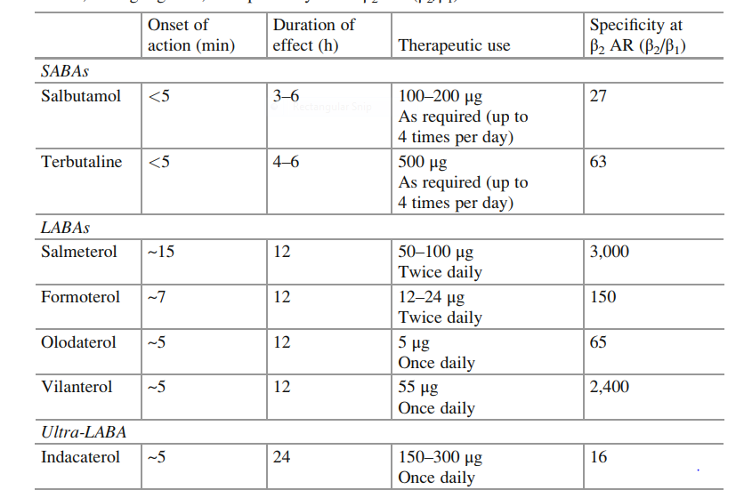
Table 1.2. clinically used β2 agonists with their respective times of onset of action, duration of effects, dosing regimen, and specificity at the β2 AR (β2/β1)

Slide 43
VII. Β3-Adrenoceptor Agonists mirabegron
the first β3-adrenoceptor (AR) agonist
for treatment of the overactive bladder (OAB) syndrome,
through various mechanisms, e.g.,
direct relaxation of detrusor muscle by stimulation of cyclic AMP (cAMP) generation,
opening of potassium channels,
inhibition of spontaneous contractile activity in the bladder, and
reduction in bladder afferent activity.

Slide 44
Mixed-Acting Sympathomimetics
Ephedrine:
a non-catecholamine, stimulates both α and β receptors.
This effect is partly by
a direct action on the receptors and
indirectly by releasing noradrenaline from its tissue stores
the effect of the drug to various organs and systems is similar to that of adrenaline.
It is also a mild CNS stimulant

Slide 45
Cont…
Absorbed from the gastrointestinal tract and from all parenteral sites.
Has a good distribution throughout the body and
is resistant to hydrolysis by the liver enzymes.
Major proportion of the drug is excreted unchanged in the urine.
Because of its stability to metabolism,
it has long duration of action than the catecholamines
Indicated for Bronchial asthma, Nasal decongestion, Heart block and Nocturnal enuresis.
side effects are similar to those of adrenaline; but in addition it may produce insomnia and retention of urine.

Slide 46
Indirect-acting sympathomimetics
amphetamine-like or “displacers
Amphetamine: is a racemic mixture of phenylisopropylamine
Its D-isomer is more potent than the L-isomer.
Amphetamine’s actions are mediated through the release of norepinephrine and,
to some extent, dopamine.
Pharmacokinetically, it is similar to ephedrine;
however, amphetamine enters the CNS even more readily,
where it has marked stimulant effects on mood and alertness and
a depressant effect on appetite.

Slide 47
Cont..
Tyramine: byproduct of tyrosine metabolism in the body
can be produced in high concentrations in protein rich foods by
  decarboxylation of tyrosine during fermentation
But it normally inactive when taken orally
  because it is readily metabolized by MAO in the liver
has an indirect sympathomimetic action through
  inducing the release of catecholamines from noradrenergic neurons

Slide 48
B. Catecholamine Reuptake Inhibitors
Atomoxetine
is a selective inhibitor of the norepinephrine reuptake transporter.
Its actions are mediated by potentiation of norepinephrine levels in noradrenergic synapses.
It is used in the treatment of attention deficit disorders
Cocaine
Inhibition of transmitter reuptake at noradrenergic synapses.
It readily enters the CNS and produces an amphetamine-like psychological effect
that is shorter lasting and more intense than amphetamine.

Slide 49
Cont…
The major action of cocaine in the CNS is
inhibit dopamine reuptake into neurons in the “pleasure centers” of the brain.
These properties have made cocaine a heavily abused drug.
Use for a local anesthetic

Slide 50
3. Adrenoceptor Antagonist Drugs
Drugs that block those receptors therefore have important effects,
some of which are of great clinical value.
These effects vary dramatically according to
the drug’s selectivity for α and β receptors, illustrated in the diagram below

Slide 51
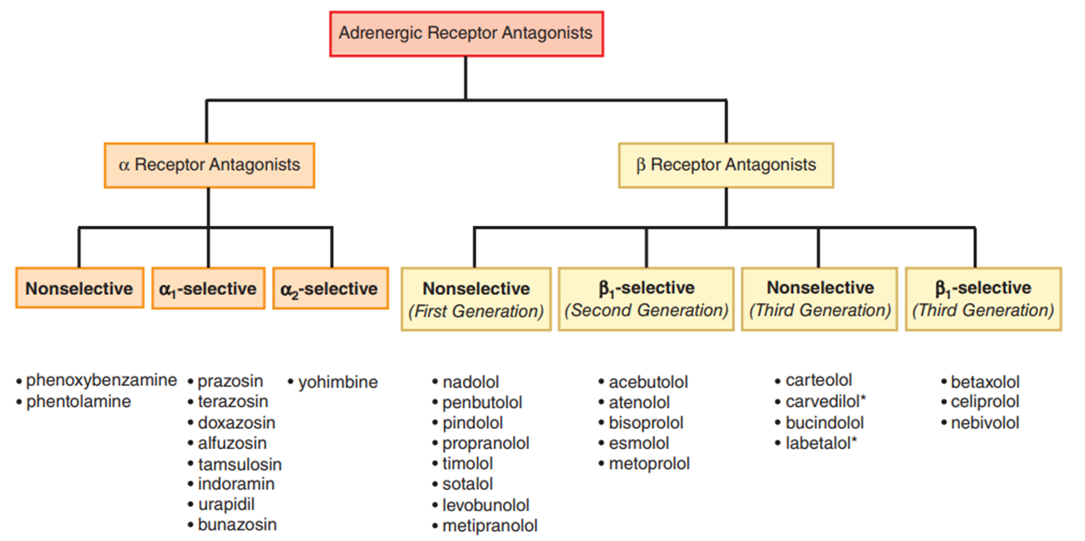

Slide 52
3.1. The Alpha-Receptor Antagonist Drugs
Phenoxybenzamine:
Non-selective Irreversible Alpha receptor antagonist.
The most significant effect is attenuation of catecholamine-induced vasoconstriction and
Cardiac output may be increased because of
  reflex effects and
  some blockade of presynaptic α2 receptors in cardiac sympathetic nerves

Slide 53
Cont…
The major use of phenoxybenzamine is , treatment of pheochromocytoma
Most adverse effects of phenoxybenzamine derive from
its α-receptor–blocking action;
  orthostatic hypotension and tachycardia
Since phenoxybenzamine enters the CNS,
it may cause less specific effects including fatigue, sedation, and nausea.

Slide 54
Cont…
Phentolamine
is a potent competitive antagonist at both α1 and α2 receptors.
Phentolamine reduces peripheral resistance through blockade of α1 receptors and possibly α2 receptors on vascular smooth muscle.
Its cardiac stimulation is due to antagonism of presynaptic α2 receptors
leading to enhanced release of norepinephrine from sympathetic nerves)
And sympathetic activation from baroreflex mechanisms

Slide 55
Cont…
principal adverse effects are related to compensatory cardiac stimulation,
which may cause severe tachycardia, arrhythmias, and myocardial ischemia.
Phentolamine has been used in the treatment of pheochromocytoma.
In addition, it is sometimes used to reverse local anesthesia in soft tissue sites;
local anesthetics are often given with vasoconstrictors that slow their removal.
Local phentolamine permits reversal at the end of the procedure.

Slide 56
Cont..
Prazosin
is a selective α1 receptor blocker
Prazosin relaxes both arterial and venous vascular smooth muscle,
as well as smooth muscle in the prostate
relative absence of tachycardia seen with prazosin compared with non selectives
  typically 1000-fold less potent at α2 receptors
extensively metabolized by liver
only about 50% of the drug is available after oral administration
The half-life is normally about 3 hours

Slide 57
Cont…
Terazosin
is another reversible α1-selective antagonist
that is effective in hypertension.
It is also approved for use in men with urinary retention symptoms
  due to benign prostatic hyperplasia (BPH).
Terazosin has high bioavailability but
is extensively metabolized in the liver,
with only a small fraction of unchanged drug excreted in the urine.
The half-life of terazosin is 9–12 hours

Slide 58
Cont…
Doxazosin
selective for α1 receptor blocker
It differs from prazosin and terazosin
having a longer half-life of about 22 hours
Tamsulosin
is a competitive α1 antagonist
Tamsulosin has higher affinity for α1A and α1D receptors than for the α1B subtype
The α1A subtype may be the most important α subtype mediating prostate smooth muscle contraction

Slide 59
Cont..
Evidence suggests that tamsulosin has relatively greater potency
in inhibiting contraction in prostate smooth muscle
versus vascular smooth muscle compared with other α1-selective antagonists.
tamsulosin has less effect on standing blood pressure in patients

Slide 60
Cont..
Yohimbine
is an α2-selective antagonist
increases central sympathetic activation and
also promotes increased norepinephrine release in the periphery
Yohimbine reverses the antihypertensive effects of α2-adrenoceptor agonists such as clonidine

Slide 61
Cont…
Alpha2 Antagonists has been experimental interest
In the development of highly selective antagonists for treatment of type 2 diabetes (α2 receptors inhibit insulin secretion)
and for treatment of psychiatric depression.

Slide 62
Beta-receptor antagonist drugs
Beta blocking drugs occupy β receptors and
competitively reduce receptor occupancy by catecholamines and other β agonists.
Most β-blocking drugs in clinical use are pure antagonists
However, some are partial agonists
some β blockers (eg, betaxolol, metoprolol) are inverse agonists
The β-receptor–blocking drugs differ in their relative affinities for β1 and β2 receptors.
this selectivity may have important clinical implications.

Slide 63
Beta-receptor antagonist drugs
Nonselective β Adrenergic Receptor Antagonists
Propranolol
interacts with β1 and β2 receptors with equal affinity,
lacks intrinsic sympathomimetic activity, and
does not block α receptors.

Slide 64
Cont…
Carvedilol, Labetalol medroxalol,* and bucindolol*
are nonselective β-receptor antagonists with some capacity to block α1-adrenergic receptors
Carvedilol antagonizes the actions of catecholamines more potently at β receptors than at α1 receptors.
Carvedilol attenuate oxygen free radical–initiated lipid peroxidation and
inhibit vascular smooth muscle mitogenesis independently of adrenoceptor blockade

Slide 65
selective β1 Adrenergic Receptor Antagonists
Metoprolol, atenolol
β1-selective group,
safer in patients who experience bronchoconstriction.
Beta1-selective antagonists preferable in patients with diabetes or peripheral vascular disease
when therapy with a β blocker is required,
  since β2 receptors are probably important in liver (recovery from hypoglycemia) and
  blood vessels (vasodilation)

Slide 66
Cont..
Nebivolol
is the most highly selective β1-adrenergic receptor blocker.
Nebivolol has the additional quality of eliciting vasodilation.
This is due to an action of the drug on endothelial nitric oxide production.
Nebivolol may increase insulin sensitivity and
does not adversely affect lipid profile.

Slide 67
Cont…
Celiprolol
is a β1-selective antagonist with a modest capacity to activate β2 receptors.
There is limited evidence suggesting that celiprolol may have less adverse bronchoconstrictor effect in asthma and
may even promote bronchodilation.

Slide 68
Clinical application of the beta-receptor–blocking drugs
Hypertension,
Ischemic Heart Disease,
Cardiac Arrhythmias,
Heart Failure,
Glaucoma,
Hyperthyroidism,
esophageal varices

Slide 69
cont…
Side effects of b-blockers:
Bradycardia, AV block, sedation, mask symptoms of hypoglycemia, withdrawal syndrome
Contraindications:
Asthma, COPD, congestive heart failure (Type IV)

Slide 70
Cholinergic Agents
Direct acting
Indirect acting
Choline esters
  Acetylcholine
  Bethanechol
  Carbachol
Alkaloids
  Nicotine
  Muscarine
  Pilocarpine
Short acting(reversible)
  Edrophonium
Medium acting(reversible)
  Neostigmine
  Pyridostigmine
  physostigmine
long acting(irreversible)
  Organophosphates
  ecothiophate
Notes:
Use of the terms reversible and irreversible depends on the duration of enzyme inhibition rather than based on strictly on mechanism

Slide 71
Choline esters
Spectrum of action
Choline ester | AChE sensitivity | CV | GI | UB | Eye | Atropine sensitive | Activity at nicotinic sites
Acetylcholine | ●●● | ●● | ●● | ● | ● | ●●● | ●●
Methacholine | ● | ●●● | ●● | ●● | ● | ●●● | ●
Carbachol | No | ● | ●●● | ●●● | ●● | ● | ●●●
Bethanecol | No | ? ●? | ●●● | ●●● | ●● | ●●● | No

Slide 72
Choline esters cont…
Acetyl choline
Limitations:
(1) lack selectivity- ACh has muscarinic and nicotinic activity.
(2) rapid degradation by cholinesterases
(3) poor absorption (Since it is a permanently charged)

Slide 73
Choline esters cont…
Spectrum of action
at cholinergic synaptic sites
  Autonomic effector sites
  Some CNS synapses
  Autonomic ganglia and the adrenal medulla
  Skeletal muscles motor end plates

Slide 74
Choline esters cont…
Bethanecol
Directly activate muscarinic M1, M2, and M3 receptors in all peripheral tissues
negligible effect at nicotinic receptors
does not enter central nervous system (CNS)
lacks AChE enzyme sensitivity

Slide 75
Alkaloids
Nicotine
Nicotine derived from tobacco
  mimics the actions of acetylcholine at nicotinic sites
  Has affinity for NN receptors than M receptors.
  stimulate ANS ganglionic transmission
  Used as an insecticide
  Blocked by hexamethonium
  Physiological responses are complex
    Depend on the dominant system
Notes:
Under normal circumstances the heart receives more parasympathetic influence than sympathetic
Ganglionic blockade would lower parasympathetic influence more than sympathetic, hence the heart rate starts to rise

Slide 76
Alkaloids cont….
Muscarine
Comes from certain mushrooms
Muscarine mimics the actions of acetylcholine
Muscarnic receptors are selectively stimulated by muscarine and bethanecol and blocked by atropine
Five types of muscarnic receptor subtypes
  M1- ganglia, secretory glands
  M2- myocardium, smooth muscles
  M3, M4- smooth muscles, secretory glands
Poisoning by muscarine produces intense effects qualitative to those produced by cholinergic stimulation of smooth muscles, cardiac muscle, and glands

Slide 77
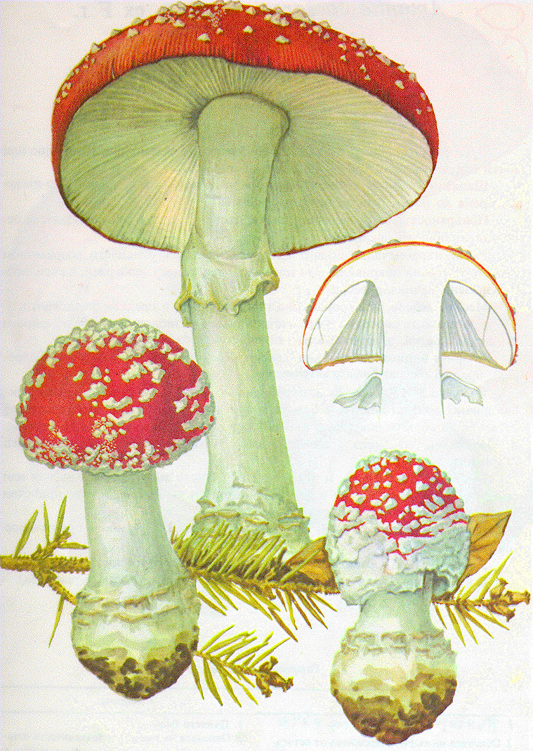
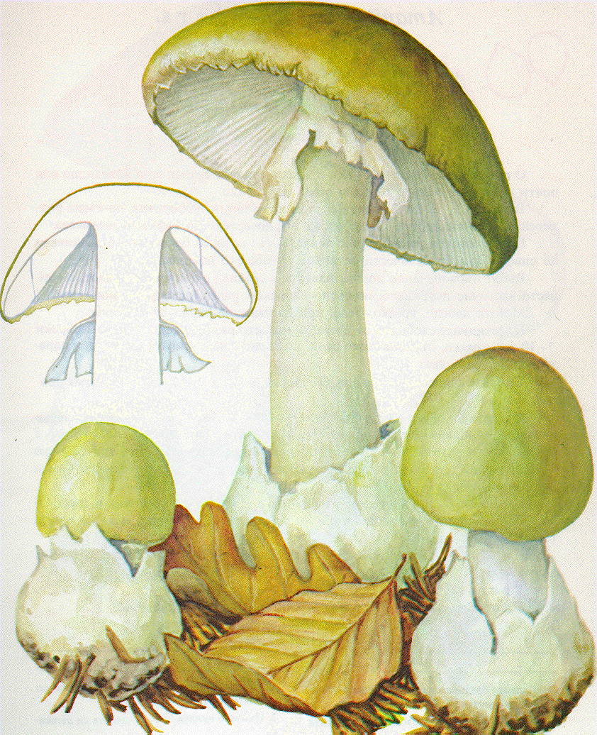
Amanita muscaria (muscarine)
Amanita phalloides (phalloidine)

Slide 78
Alkaloids cont….
Pilocarpine
Has muscarinic actions
Primarily used in ophthalmology to lower IOP as an eye drop.
Lowers IOP by constricting pupil and facilitate out flow of aqueous humor.
  Become the standard initial drug for treating open angle glaucoma
  Used for xerostomia

Slide 79
Indirect acting cholinomimmetics
AChEIs
Reversible- Short acting
  eg- edrophonium, tacrine
Carbamylating agents- Intermediate acting
  Eg- Neostigmine and Physostigmine
Phosphorylating agents- long acting
  Eg. Organophosphates:
            Malathion, Parathion, Echothiophate (N⁺), Sarin

Slide 80
Therapeutic Uses reversible inhibitors of AChEIs
  Edrophonium- Diagnosis of myasthenia gravis
      reversible and rapid renal clearance
Tacrine- For treatment of alzhimer’s disease
  more lipophilic and has longer duration

Slide 81
Carbamylating agents-
Physostigmine
Neostigmine (N⁺)
Pyridostigmine (N⁺)
Form moderately stable complex with AChE, lasts from 3-4 hrs
  The carbamyl estrase linkage is hydrolysed by the estrase, but at much more slowly compared to acetylcholine
Neostigmine and pyridostigmine are quaternary ammonium salts hence can not cross BBB
  Not therapeutically used for treatment of atropine poisoning only physostigmine is used

Slide 82
Carbamylating agents …..
physostigmine and organophosphates have more marked muscarinic and CNS effects, stimulates ganglia
neostigmine and pyridostigmine produce more marked effect on the skeletal muscles -direct action on
    muscle end-plate(N_{M} )
    Also stimulate ganglia(N_{N}) but
    muscarinic effects are less prominent.
      They do not penetrate in CNS and have no central effects.

Slide 83
Carbamylating agents….
Therapeutic uses
Glaucoma (wide angle)
Atony of the bladder
Atony of the gastrointestinal tract
Intoxication by antimuscarinic agents
    (use physostigmine)
Recovery of neuromuscular function after competitive blockade of NM receptor of skeletal muscle fibers
Myasthenia gravis

Slide 84
Treatment of organophosphate poisoning
Pralidoxine- cholinestrase activator
  Used as an antidote
Does not cross the BBB
has to be given very early after poisoning as with in a few hours of phosphorylated enzyme under goes a change(aging) that renders it no longer susceptible for reactivation
also use a muscarnic antagonist (atropine) or muscle relaxant.

Slide 85
Therapeutic uses of cholinomimetic agents
1. Treatment of Glaucoma
open-angle glaucoma- treatment options into two classes
    a. reduction of aqueous humor secretion
    b. enhancement of aqueous outflow.
  Cholinomimetics (enhance flow)
  α agonists (reduce synthesis)
  β blockers (reduce synthesis)
  prostaglandin F2α analogs (enhance flow)
  diuretics (reduce synthesis)
Open-angle glaucoma can be effectively treated with cholinomimetics such as pilocarpine and carbachol
Closed-angle glaucoma occurs when iris fall forward touches cornea and treated by surgical removal of part of the iris (iridectomy).

Slide 86
2. Treatment of myasthenia gravis
Caused by the binding of antinicotinic receptor antibodies to the nicotinic cholinergic receptors
Muscle weakness and rapid fatigue of muscles are characteristics of the disease.
Cholinomimetic agents help to alleviate the weakness
  elevating and prolonging the concentration of ACh in the synaptic cleft
  producing a greater activation of the remaining nicotinic receptors.
  Pyridostigmine and neostigmine are the major.

Slide 87
3. Treatment of Urinary retention
  The drug of choice is bethanecol.
4. Treatment of GI disorder
  Gastric atony or paresis (delay in gastric emptying that occur mainly in diabetic patients).
  Bethanecol is drug of choice.
5. Treatment of xerostomia
  A disorder characterized by decrease in salivary and lacrimal gland secretions.
  Pilocarpine is helpful.

Slide 88
6. Treatment of Alzheimer’s disease
neurodegenerative disease that produces a progress loss of memory and cognitive function.
These functional changes appear to result primarily from the loss of cholinergic transmission in the neocortex.
Donepezil, Rivastigmine, Tacrine and Galanthamine.
  Cross BBB to produce a reversible inhibition of AChE in the CNS.
  Tacrine is associated with hepatotoxicity.

Slide 89
Adverse effects of cholinomimetic agents
Salivation
Diaphoresis
Colic
Headache
GI hyperactivity
Loss of accommodation

Slide 90
Contraindications
Asthma patients
Patients with hypotension and heart failure
Peptic ulcer
GI and urinary obstructive diseases.

Slide 91
Muscarinic blocking drugs
selectively antagonize the responses to acetylcholine and other parasympathomimetics.
(1) Alkaloids- atropine and scopolamine(hyoscine)
(2) Semi synthetic derivatives -differ from the parent compound in their disposition in the body or their duration of action
Quaternary ammonium compounds
do not cross the BBB or readily cross membranes.
Methylatropine, ipratropium, homatropine, methyl scopolamine
Tertiary amine compounds
cross the BBB
benztropine, oxybutin and dicyclomine

Slide 92
Muscarnic blockers cont…..
Atropine
Source
  Atropa belladonna
  Datura stramonium
  Hyoscyamus nigra
Chemical nature
  Alkaloid
Nature of blockade
  Competitive

Slide 93
Atropine….
Mechanism compete with ACh at muscarinc receptor
At high concentration it blocks ACh at NN and NM receptor
Pharmacologic effect
Scopalamine(more marked) and atropine(minimal)CNS stimulatory effect
reversing vestibular disturbances, especially motion sickness, appear to involve muscarinic cholinergic transmission
  Scopolamine is effective in preventing or reversing these disturbances.

Slide 94
Atropine…
CVS
Moderate to High doses- increased heart rate
  Used for Brady cardia
  1 mg of atropine is needed
low doses- the predominant effect is a decreased heart rate
Blood vessels
Vasoconstriction in coronary and skeletal muscle blood vessels
Exocrine gland - decreased secretion from salivary, bronchial, Sweat gland and Acid secreting cells of the stomach

Slide 95
Atropine…..
Smooth muscles
  Relaxation of the bronchi
  Decreased tone of the urinary bladder
  Decreased tone & motility of the GIT
  reduce secretion
  Gastric secretion is blocked less effectively
    volume and amount of acid, pepsin, and mucin are all reduced, but large doses of atropine may be required.
Eye - Mydriasis

Slide 96
Atropine….
Therapeutic use:
  For ocular examination
  pre anesthetic agent by decreasing respiratory secretion
  Bradycardia
  for poisoning by anti cholinesterase agent such as Malathion.
S/E - blurred vision, photophobia, dry mouth, urinary retention, constipation, elevation of IOP

Slide 97
Selective antimuscarinic agents
Pirenzepine and telenzepine are selective for M3 receptors located in the gastric parietal cells
  the treatment of peptic ulcer disease
oxybutynin are selective for M3 receptor on urinary bladder
  treatment of urinary incontinence.

Slide 98
Adverse effects blocking drugs
Xerostomia
Photophobia
Hyperpyrexia
Hallucinations
Tachycardia

Slide 99
Contraindications
Narrow angle glaucoma
Hypertrophy of the prostate gland
Atony of the bladder
Atony of the GI Tract

Slide 100
Drugs Acting On Central Nervous System

